Slide 1
Data Management Planning
Fernando Aguilar

Slide 2
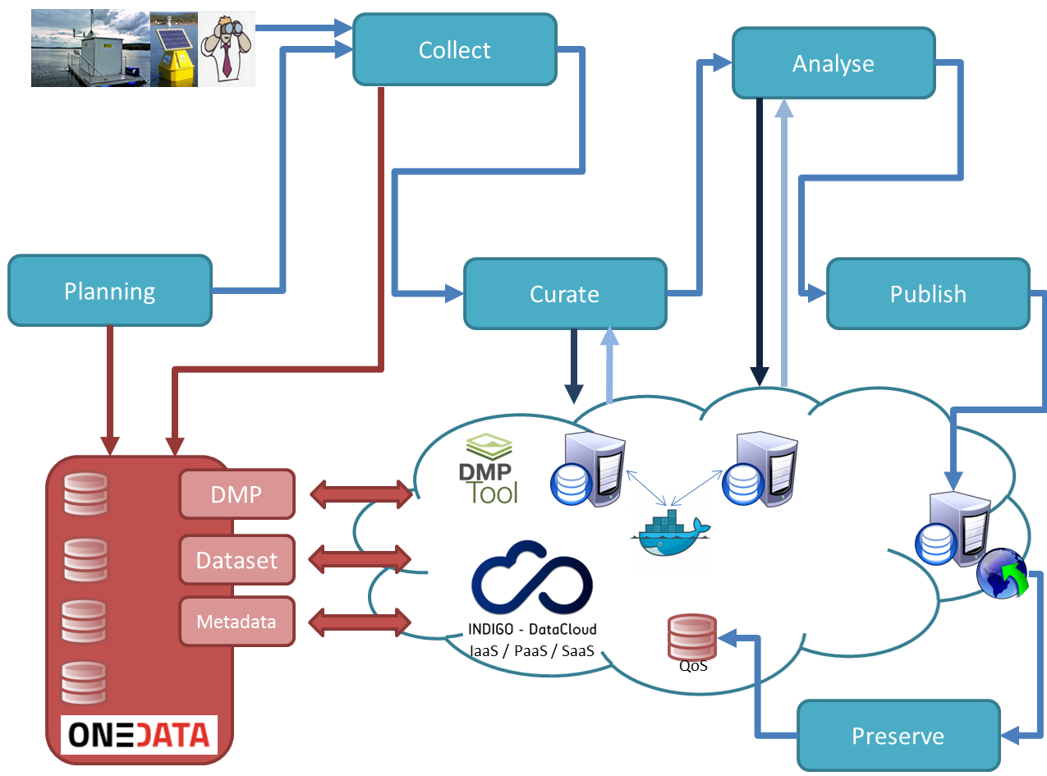
INDIGO Data Life Cycle (“6S”)
M3.02 – Data Life Cycle Fernando Aguilar
2

Slide 3
INDIGO Data Life Cycle (“6S”)
Stage 1: Plan: prepare a Data Management Plan, including how data will be gathered, metadata definition, preservation plan, etc.
Stage 2: Collect: including both creation and acquisition, it is the process of getting data, in different ways. A storage service is needed as well.
M3.02 – Data Life Cycle Fernando Aguilar
3

Slide 4
INDIGO Data Life Cycle (“6S”)
Stage 3: Curate: also known as “Transform”: using the raw data collected in the previous stage, manual or automatic actions are performed over the data, which is converted and also filtered.
Stage 4: Analyse: an optional step also called “Process”, that implies performing different actions to give the data an added value and get new derived data.
M3.02 – Data Life Cycle Fernando Aguilar
4

Slide 5
INDIGO Data Life Cycle (“6S”)
Stage 5: Ingest (& Publish): including other steps like “Access”, “Use” or “Re-use”, in this stage, data is normally associated to metadata, gets a persistent identifier (a DOI) and is published in an accessible repository or catalogue, under a format that makes it useful for further re-use.
Stage 6: Preserve: "store" both data and analysis for long-term. Licenses and methods need to be taken into account.
Ingestion
M3.02 – Data Life Cycle Fernando Aguilar
5

Slide 6
Data Management Plan
A DMP is a document (or similar) to define:
How the data will be created.
How it will be documented.
Who will be able to access it (and how).
Where (and how) will be stored.
Who will back it up.
Whether (and how) it will be shared & preserved.
DMPs are often submitted as part of grant applications, but they are useful whenever scientists are creating data.
G8, 2003, regarding funded projects:
“Open scientific research data should be easily discoverable, accessible, assessable, intelligible, usable, and wherever possible interoperable to specific quality standards”.

Slide 7
Data Management Plan
Formal Document (Document?)
Outlines what you will do with your data during and after you complete your research
Ensure your data is safe for the present and the future
From University of Virginia Library

Slide 8
Why DMPs?
Facilitate data reusing. DMPs contain a coherent set of sections describing how data life cycle is handled. Therefore, data can be tracked along its life, including mechanisms to ensure the provenance traceability.
Ensure Reproducibility. DMPs describe all the elements related to the data gathering, curation, and analysis, so the results of the research can be reproduced in the future.
Control costs. DMPs provide the funders a way to estimate and limit the costs associated with data collection. Data Management Plans must include a clear description of the purpose of the data gathering, including what is needed for the research project and the expected results or findings.
Think before act. The preparation of a DMP is the phase where all the elements that may influence the data life cycle can be integrated from a global perspective. This way, the resources can be optimized and no-sense or duplicated actions avoided.
Capture requirements along all the data life cycle phases. Although DMPs are sometimes considered as a static document, ideally it can be progressively updated taking into account the evolution along the data life cycle. DMPs should not be “closed” before the project starts, as unexpected issues will appear, nor “started” by the end of the project, when data may even have disappeared.

Slide 9
DMPs Approach
As open as possible, as closed as necessary.
DMP is a living document. Should be changed during the project.
Different implementations available:
DMPonline
DMPtool
DMPRoadmap
RDA Working Groups
New developments towards machine-actionability.
Oriented to create “FAIR” Data.

Slide 10
Concepts (To be clear…)
Metadata: Data about data. Describes the context, the content and the structure of a dataset.
Machine-actionable or Machine-readable: features that allows a software to automatize any action.
FAIR: See next slide.
DOI (Digital Object Identifier): implementation of a persistent identifier that can be assign to any digital object.
Ontology: a formal naming and definition of the types, properties, and interrelationships of the entities that really exist in a particular domain.
See European Commission H2020 DMP Guidelines:
http://ec.europa.eu/research/participants/data/ref/h2020/grants_manual/hi/oa_pilot/h2020-hi-oa-data-mgt_en.pdf

Slide 11
What is FAIR Data?
FAIR Data aims to support existing communities in their attempts to enable valuable scientific data and knowledge to be published and utilized in a ‘FAIR’ manner.
Findable - (meta)data is uniquely and persistently identifiable. Should have basic machine readable descriptive metadata.
Accessible - data is reachable and accessible by humans and machines using standard formats and protocols.
Interoperable - (meta)data is machine readable and annotated with resolvable vocabularies/ontologies.
Reusable - (meta)data is sufficiently well-described to allow (semi)automated integration with other compatible data sources.
Reproducible – Elements related to data are identified and relationships are well known (software, methods, related dataset, etc.).

Slide 12
Implementation approach
Findable - standards for describing the dataset with the relevant metadata;
Accessible - standards for represent and access the data according to the defined usage license;
Interoperable - standards for machine readable descriptions of the (meta)data and (semantic)annotation;
Reusable - standards for semantic annotation of the (meta)data supporting machine reasoning, and standards for defining data provenance and support citation;
The standards include technologies (e.g., RDF, nano pub, JSON, OWL, etc.) as well as protocols and APIs.

Slide 13
DMPs in funding programs
NSF (National Science Foundation, US)
“Investigators are expected to share with other researchers, at no more than incremental cost and within a reasonable time, the primary data, samples, physical collections and other supporting materials created or gathered in the course of work under NSF grants”
EC H2020: The European Commission DMP approach is oriented to make the data generated by a funded project “FAIR” and to ensure that the new data will be available, under certain conditions, for other researchers or even citizens aiming to use it if the security or ethical aspects allow doing so. Templates provided include in many cases the description of the software used during the data life cycle, aiming to ensure also data reproducibility.

Slide 14
Components of a General DMP
Information about data & data format
Metadata content and format
Policies for access, sharing and re-use
Long-term storage and data management
Budget
Notes:
For a general DMP, there are five main categories of information that should be included. Some funders or institutions may require specific elements in a data management plan; you should check with the agency or group for which you are preparing your DMP before beginning.
The slides that follow will go into more detail for each of the general categories on this slide. They are 1) Information about the data and its format, 2) information about the metadata content and format that will be used, 3) policies for access, sharing, and reuse of data, 4) long-term storage and data management, and 5) budget considerations for data management.

Slide 15
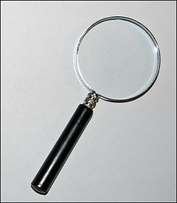

1. Information About Data & Data Format
1.1 Description of data to be produced
Experimental
Observational
Raw or derived
Physical collections
Models and their outputs
Simulation outputs
Curriculum materials
Software
Images
Etc…
CC image by Jeffery Beall on Flickr
Notes:
There are many different types of data that may be produced by a research study. Consider this list when describing data that will be produced by the project. These include experimental and observational data, raw or derived data, physical collections, models and their outputs, outputs from simulations, curriculum materials for courses, software, images, etcetera.
More information can be found at http://www.ed.ac.uk/schools-departments/information-services/services/research-support/data-library/research-data-mgmt/data-mgmt/research-data-definition

Slide 16

1. Information About Data & Data Format
1.2 How data will be acquired
When?
Where?
1.3 How data will be processed
Software used
Algorithms
Workflows
CC image by Ryan Sandridge on
Flickr
Notes:
In addition to a description of the data that will be generated, the methods of data acquisition should be specified. Include the who, what, when, where of your collection.
How will the data be processed once it is acquired? This step is important to consider before the project since it may affect how data are organized, what formats are used, and how much should be budgeted for hardware and software. Things to consider are what software may be used, what algorithms will be employed, how these fit into the overall workflow of the project.

Slide 17

1. Information About Data & Data Format
1.4 File formats
Justification
Naming conventions
1.5 Quality assurance & control during
sample collection, analysis, and
processing
CC image by Artform Canada on Flickr
Notes:
You should also describe the file formats you plan to use for your data. When saving files for the long term, it’s best to use standard formats such as dot csv or dot txt. These are nonproprietary and likely to be readable in the future, regardless of software availability.
Whatever format you choose, you should justify your choice. Consider what standards are commonly used in your scientific discipline when deciding.
Also describe the naming conventions that will be used for your data sets, files, and folders. By determining these conventions ahead of time, you are less likely to need to change or reorganize files during the project.
You should also identify what quality assurance and control measures you plan to take. Include what will be done during data collection, after data collection, and in the course of data analysis.

Slide 18
1. Information About Data & Data Format
1.6 Existing data
If existing data are used, what are their origins?
Will your data be combined with existing data?
What is the relationship between your data and existing data?
1.7 How data will be managed in short-term
Version control
Backing up
Security & protection
Who will be responsible
Notes:
It is also important to identify any existing data you may use, including their origins, and how the data you collect will relate to those data.
If your dataset will be combined in the future with existing data, how you will ensure that formats are compatible? What is the relationship between the data you are collecting and what already exists?
You should describe how data will be managed in the short term. How will you keep track of different versions of your data and analyses? How will you back up your data? Are servers available at your institution? Consider both on-site and off-site backup options. Describe how you will ensure the security of your data, especially if your data are sensitive. Who will have access to the data?
Be sure to identify who will be responsible for short-term data management. Assign roles and responsibilities for data management, archiving, version control, and backing up.

Slide 19
2. Metadata Content & Format
Metadata defined:
Documentation and reporting of data
Contextual details: Critical information about the dataset
Information important for using the data
Descriptions of temporal and spatial details, instruments, parameters, units, files, etc.
Notes:
The second major category for a DMP is metadata content and format. First, we should define metadata. Metadata is data documentation. It includes contextual details about data collection and any information that is important for using and understanding the data. Examples of some of the many components of metadata are temporal and spatial details, instruments used, parameters, units, etcetera.

Slide 20
2. Metadata Content & Format
2.1 What metadata are needed
Any details that make data meaningful
2.2 How metadata will be created and/or captured
Lab notebooks? GPS units?
Auto-saved on instrument?
2.3 What format will be used for the metadata
Standards for community
Justification for format chosen
Notes:
This section of the DMP should first describe how the metadata will be created or captured. For instance, will field or lab notebooks be used to record critical information? Will instruments such as GPS units be implemented for data collection? Will metadata be saved automatically by the instrument you are using?
Indicate what format, or metadata standard, will be used. There are many different metadata standards available. Ask colleagues about what is commonly used in your discipline. Also, check with the repository or data center with which you plan to archive your data - many have metadata format requirements. Justify the format you choose for your metadata, considering your research community, the data center you will use, and the nature of the project.

Slide 21
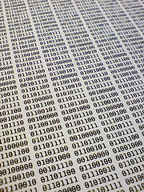
3. Policies for Access, Sharing, Reuse
3.1 Obligations for sharing
Funding agency
Institution
Other organization
Legal
3.2 Details of data sharing
How long?
When?
How access can be gained?
Data collector rights
3.2 Ethical/privacy issues with data sharing
CC image by Jim Sher on Flickr
Notes:
The third section of a data management plan should describe policies for access, sharing, and reuse of your data.
What obligations do you have to share your data? Sharing requirements may come from your institution, your funder, or your professional society. There may also be legal obligations for sharing your data.
You should also describe the details of how you will share your data. How long after collection will data be available? When will access be granted to interested users? Who will have access to those data? How will they gain access? Will the data collector, creator, or PI have exclusive rights to data for a certain period of time?
Be sure to address any ethical or and privacy issues associated with your data. For example, If your data involves human subjects, endangered species, or locations of sensitive habitats, you may have special considerations for data sharing.

Slide 22

3. Policies for Access, Sharing, Reuse
3.4 Intellectual property & copyright issues
Who owns the copyright?
Institutional policies
Funding agency policies
Embargos for political/commercial reasons
3.5 Intended future uses/users for data
3.6 Citation
How should data be cited when used?
Persistent citation?
CC image by buddawiggi on
Flickr
Notes:
Describe any intellectual property or copyright issues associated with your data. Who owns the copyright to your data? Institutions and/or funding agencies often have a policy for intellectual property and copyright. There may be other considerations such as embargos on data due to patents, politics, or journal requirements.
Be prepared to describe the intended future uses and users of your data. This helps determine the most appropriate data center to archive your data.
You should also describe how your data should be cited when used. It is best to establish a persistent identifier or citation, such as a DOI, or digital object identifier. Consult policies and options with the data archive you choose.

Slide 23




4. Long-term Storage & Data Management
4.1 What data will be preserved
4.2 Where will it be archived
Most appropriate archive for data
Community standards
3.6 Data transformations/formats needed
Consider archive policies
4.4 Who will be responsible
Contact person for archive
Notes:
The fourth major section of a data management plan describes plans for long term storage and data management.
First, you should describe what data will be preserved. Not all data should necessarily be preserved. In general, any raw data should be kept. Also, any data products that were particularly expensive or time consuming to obtain should be preserved. Any data that is not easily replaceable should be kept.
Second, identify where you will archive your data. Find out what archives or data centers are commonly used in your discipline. Data centers usually last longer than lab or personal websites. Check to see if your institution has a repository available to researchers. Also, ask colleagues in your field where data are commonly archived.
Third, your data management plan should describe what data transformations and formats need to be preserved to ensure future usability of your data. Contact the data repository you will use early in the project to be sure you have data in the correct format. This will save time later.
Fourth, identify the person who will be responsible for maintaining contact information with the data center. This is especially important if there are restrictions on data use, for instance a requirement that potential users contact the data collector before reusing data.

Slide 24

5. Budget
5.1 Anticipated costs
Time for data preparation & documentation
Hardware/software for data preparation & documentation
Personnel
Archive costs
5.2 How costs will be paid
CC image by Adria Richards on Flickr
Notes:
The fifth and final component of a general DMP is budget. Although most proposals have separate budget requirements, it is important to consider costs that might be incurred in the process of managing and preserving your data.
Consider costs such as salary time needed for data preparation and documentation, hardware and software requirements, personnel needed to prepare data, and costs associated with archiving your data.
You should identify how the costs associated with your DMP will be paid.

Slide 25
H2020 DMP
1. DATA SUMMARY
What is the purpose of the data collection/generation and its relation to the objectives of the project?
What types and formats of data will the project generate/collect?
Will you re-use any existing data and how?
What is the origin of the data?
What is the expected size of the data?
To whom might it be useful ('data utility')?

Slide 26
H2020 DMP
2. FAIR DATA
Making data findable, including provisions for metadata
Are the data produced and/or used in the project discoverable with metadata, identifiable and locatable by means of a standard identification mechanism (e.g. persistent and unique identifiers such as Digital Object Identifiers)?
What naming conventions do you follow?
Will search keywords be provided that optimize possibilities for re-use?
Do you provide clear version numbers?
What metadata will be created? In case metadata standards do not exist in your discipline, please outline what type of metadata will be created and how.

Slide 27
H2020 DMP
2. FAIR DATA
Making data openly accessible
Which data produced and/or used in the project will be made openly available as the default? If certain datasets cannot be shared (or need to be shared under restrictions), explain why, clearly separating legal and contractual reasons from voluntary restrictions.
Note that in multi-beneficiary projects it is also possible for specific beneficiaries to keep their data closed if relevant provisions are made in the consortium agreement and are in line with the reasons for opting out.
How will the data be made accessible (e.g. by deposition in a repository)?
What methods or software tools are needed to access the data?
Is documentation about the software needed to access the data included?
Is it possible to include the relevant software (e.g. in open source code)?
Where will the data and associated metadata, documentation and code be deposited? Preference should be given to certified repositories which support open access where possible.
Have you explored appropriate arrangements with the identified repository?
If there are restrictions on use, how will access be provided?
Is there a need for a data access committee?
Are there well described conditions for access (i.e. a machine readable license)?
How will the identity of the person accessing the data be ascertained?

Slide 28
H2020 DMP
2. FAIR DATA
Making data interoperable
Are the data produced in the project interoperable, that is allowing data exchange and re-use between researchers, institutions, organisations, countries, etc. (i.e. adhering to standards for formats, as much as possible compliant with available (open) software applications, and in particular facilitating re-combinations with different datasets from different origins)?
What data and metadata vocabularies, standards or methodologies will you follow to make your data interoperable?
Will you be using standard vocabularies for all data types present in your data set, to allow inter-disciplinary interoperability?
In case it is unavoidable that you use uncommon or generate project specific ontologies or vocabularies, will you provide mappings to more commonly used ontologies?

Slide 29
H2020 DMP
2. FAIR DATA
Increase data re-use (through clarifying licences)
How will the data be licensed to permit the widest re-use possible?
When will the data be made available for re-use? If an embargo is sought to give time to publish or seek patents, specify why and how long this will apply, bearing in mind that research data should be made available as soon as possible.
Are the data produced and/or used in the project useable by third parties, in particular after the end of the project? If the re-use of some data is restricted, explain why.
How long is it intended that the data remains re-usable?
Are data quality assurance processes described?

Slide 30
H2020 DMP
3. ALLOCATION OF RESOURCES
What are the costs for making data FAIR in your project?
How will these be covered? Note that costs related to open access to research data are eligible as part of the Horizon 2020 grant (if compliant with the Grant Agreement conditions).
Who will be responsible for data management in your project?
Are the resources for long term preservation discussed (costs and potential value, who decides and how what data will be kept and for how long)?
4. DATA SECURITY
What provisions are in place for data security (including data recovery as well as secure storage and transfer of sensitive data)?
Is the data safely stored in certified repositories for long term preservation and curation?
5. ETHICAL ASPECTS
Are there any ethical or legal issues that can have an impact on data sharing? These can also be discussed in the context of the ethics review. If relevant, include references to ethics deliverables and ethics chapter in the Description of the Action (DoA).
Is informed consent for data sharing and long term preservation included in questionnaires dealing with personal data?

Slide 31
H2020 DMP
6. OTHER ISSUES
Do you make use of other national/funder/sectorial/departmental procedures for data management? If yes, which ones?
7. FURTHER SUPPORT IN DEVELOPING YOUR DMP
The Research Data Alliance provides a Metadata Standards Directory that can be searched for discipline-specific standards and associated tools.
The EUDAT B2SHARE tool includes a built-in license wizard that facilitates the selection of an adequate license for research data.
Useful listings of repositories include:
Registry of Research Data Repositories
Some repositories like Zenodo, an OpenAIRE and CERN collaboration), allow researchers to deposit both publications and data, while providing tools to link them.
Other useful tools include DMP online and platforms for making individual scientific observations available such as ScienceMatters.

Slide 32
H2020 DMP
DMP services. Example: DMPonline
https://dmponline.dcc.ac.uk/

Slide 33
DMPs - Proyectos

Slide 34
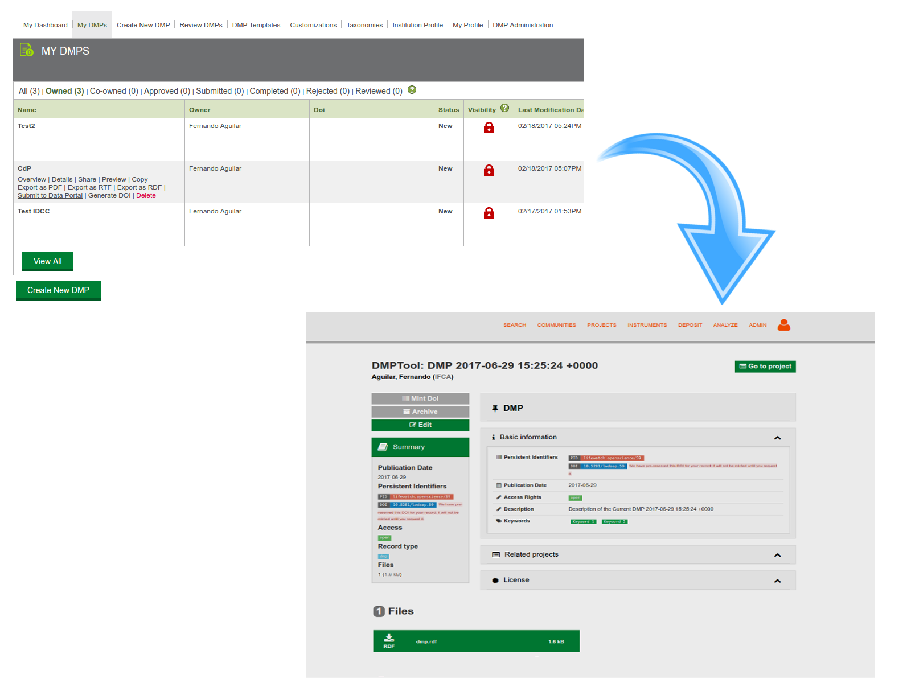
Regarding Machine-actionability

Slide 35
Regarding Machine-actionability
Semantic layer:
https://bioportal.bioontology.org/ontologies/SWEET

Slide 36
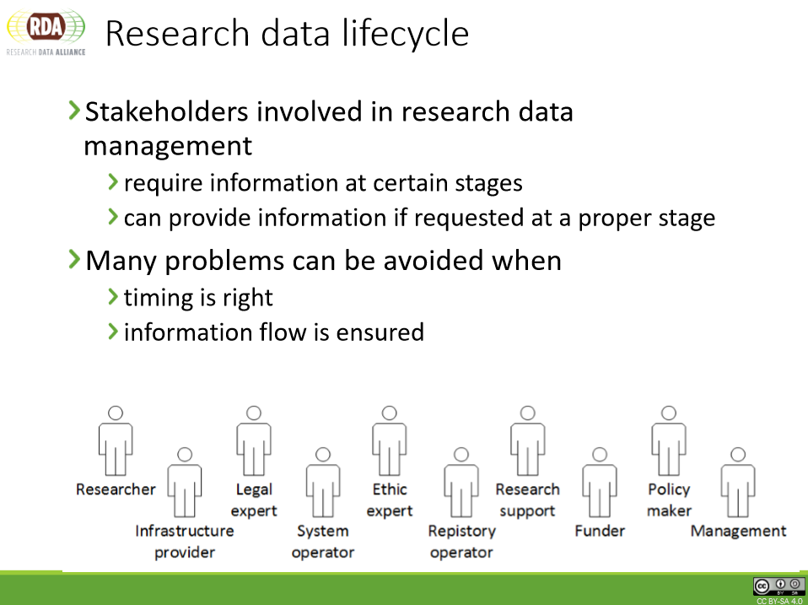
Tomasz Miksa, Paul Walk, Peter Neish

Slide 37
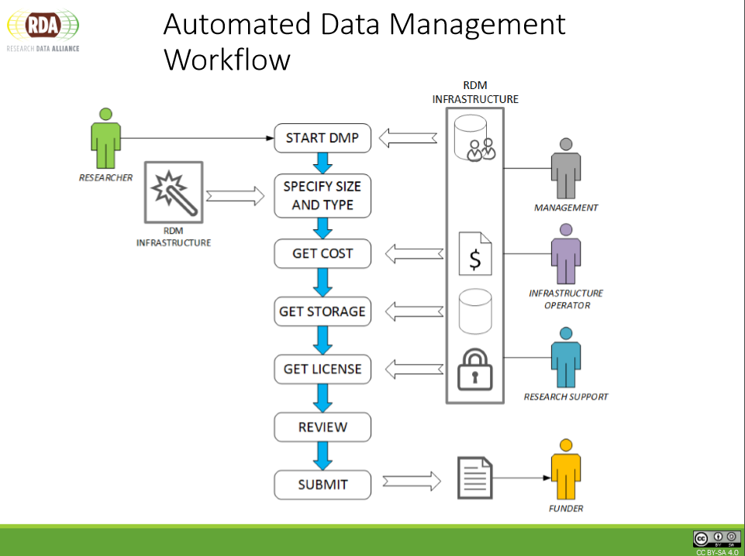

Slide 38
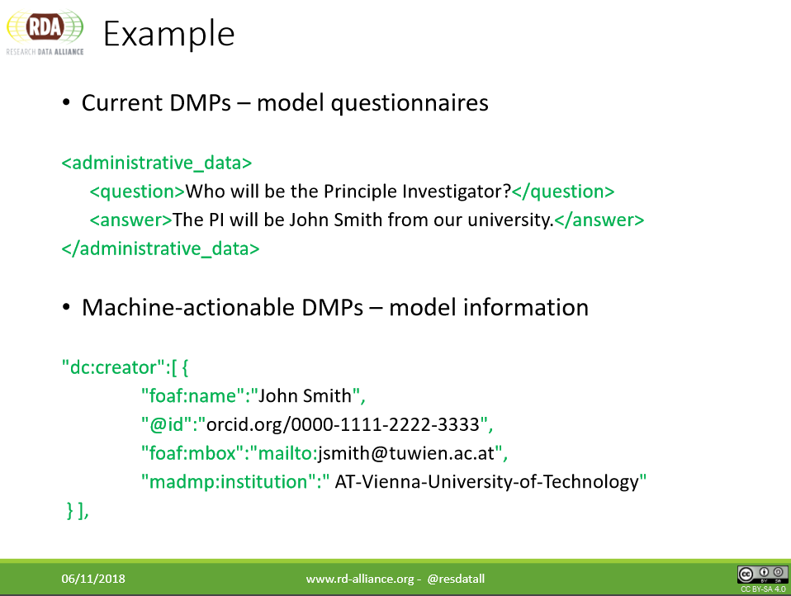

Slide 39
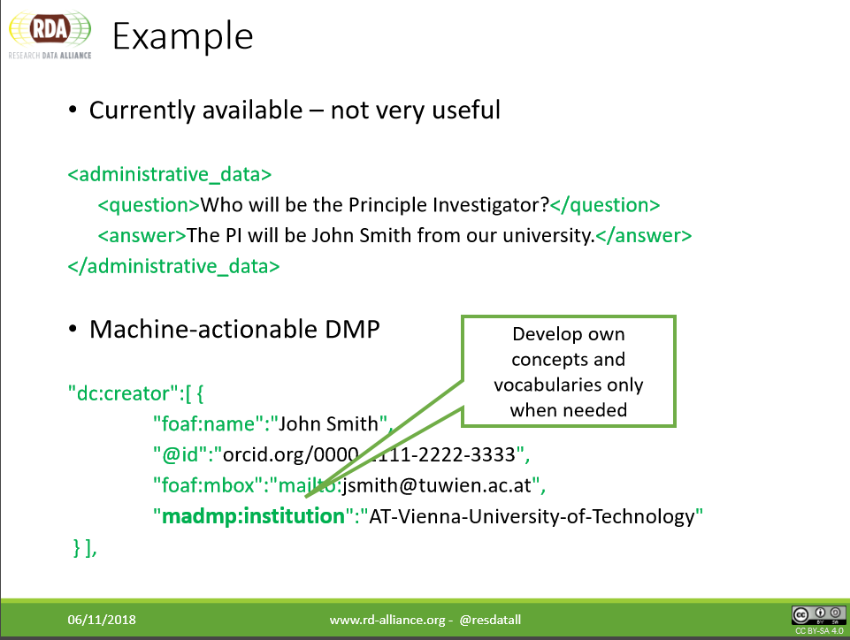
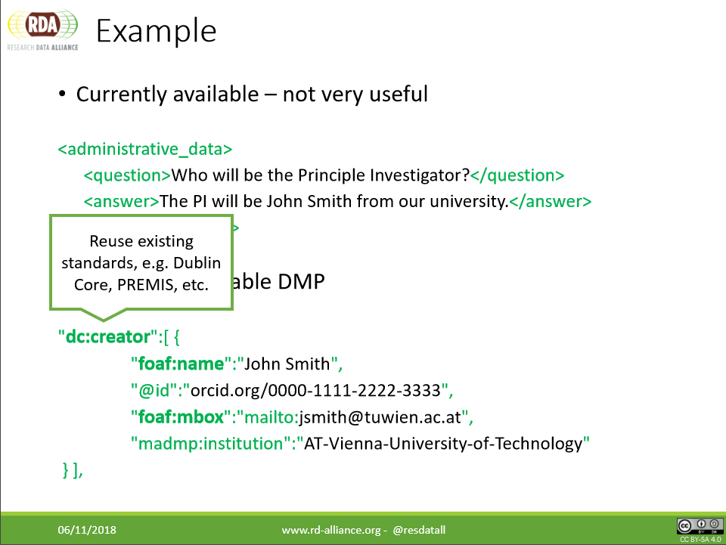

Slide 40
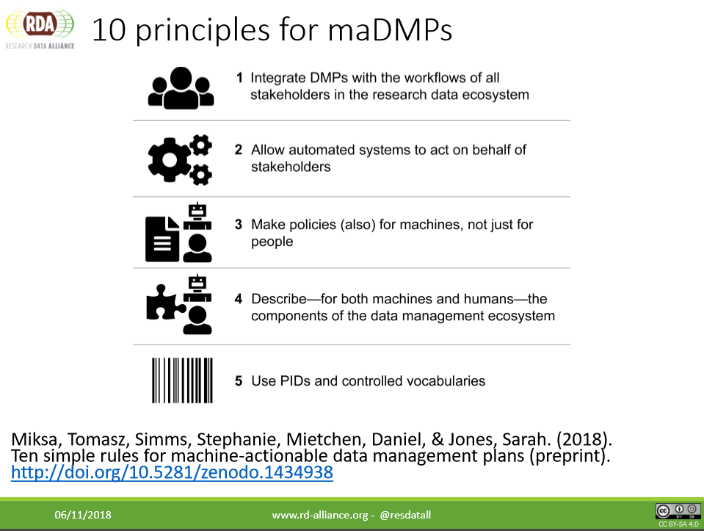

Slide 41
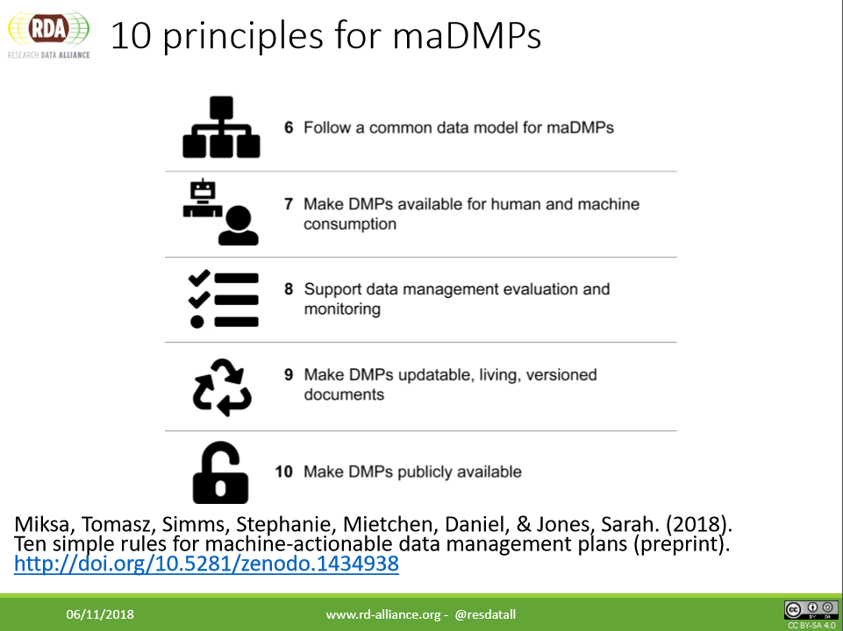

Slide 42
New developments
https://github.com/oblassers/dmap
https://github.com/RDA-DMP-Common/RDA-DMP-Common-Standard

